Slide 1
RECURSIVE NEURAL NETWORK
Team 24

Slide 2
Agenda
Introduction to RNN
Natural language processing with RNN
Merging representations
Training

Slide 3
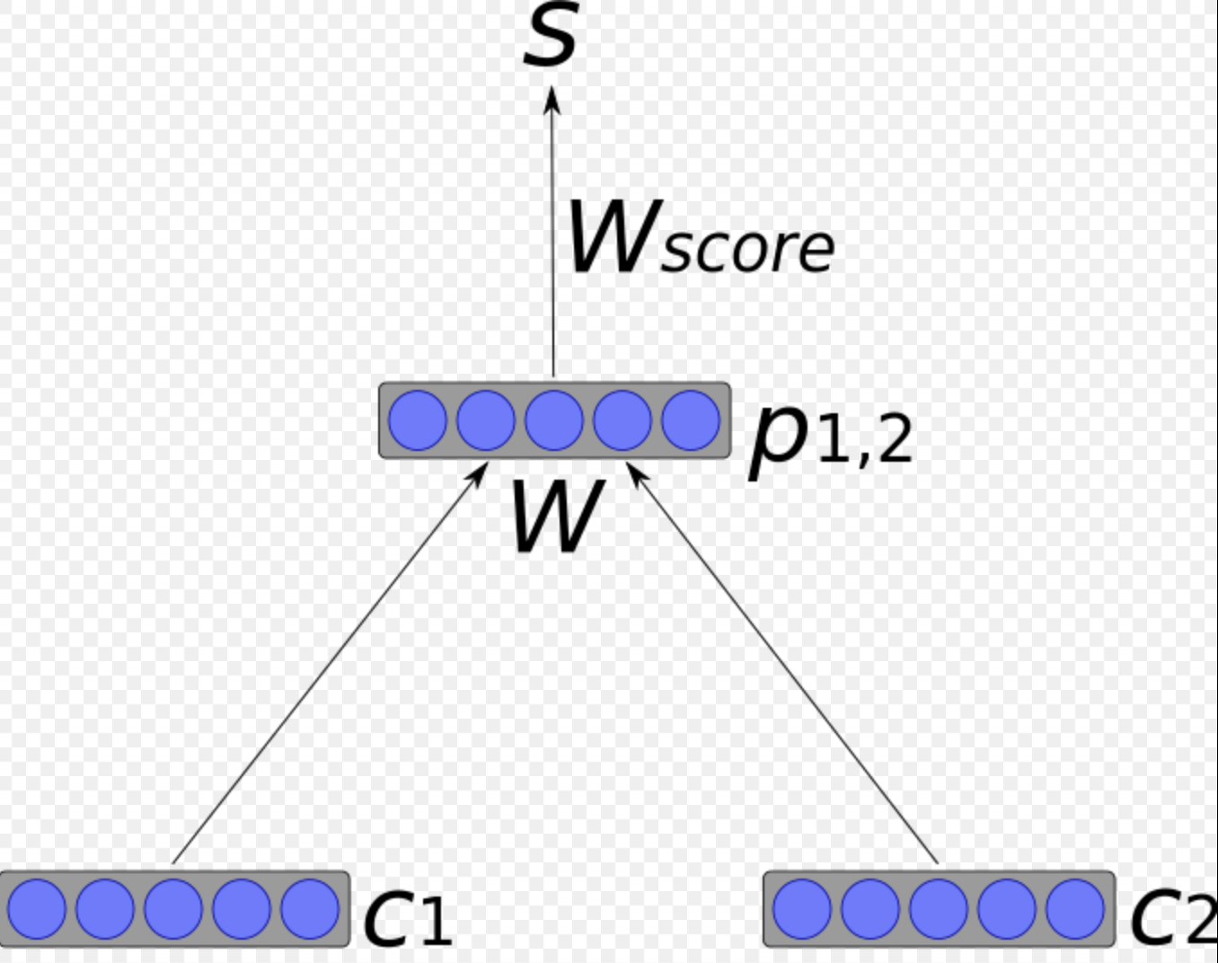
Introduction
RNN is a kind of a deep neural network in which we traverse over a given structure topologically and apply same set of weights recursively over a structure to produce a structured prediction.
Basic architecture: A parent node is formed by merging two nodes.
P_{1,2} = tanh(W[c1:c2])
c1, c2 – n-dimensional vectors
W – weight matrix n x 2n

Slide 4
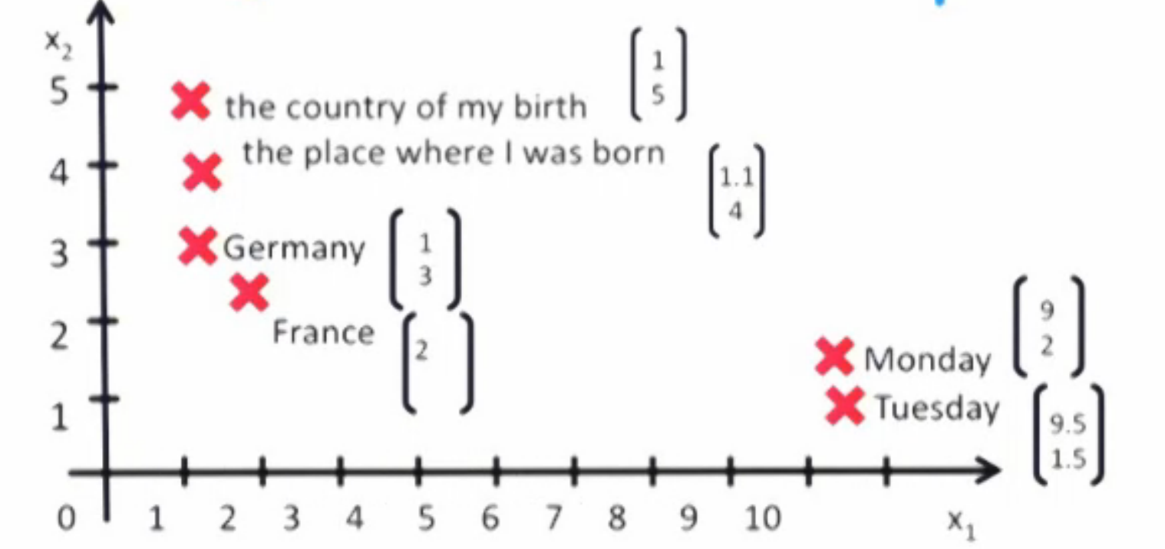

NLP with RNN
Background: Earlier NLP methods captured words in isolation without any context.
Need to capture the semantics(context) of words/sentences.
Need a way to represent long phrases
in the same vector space
RNN used in sentiment analysis, relation
Classification, parsing.

Slide 5
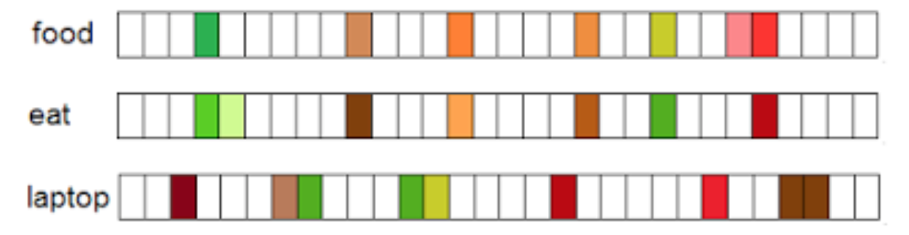
Word is represented as a distributional vector or word embedding to capture the context.
Each word is a n-dimensional vector where each entry in the vector corresponds to an index in the vocabulary.
Select a window of neighboring words around the target word and increase the count of indexes that represent the neighboring words.
Each word vector contains the frequencies of all its neighbors.
(Notice that the vectors for the words food and eat are similar)

Slide 6

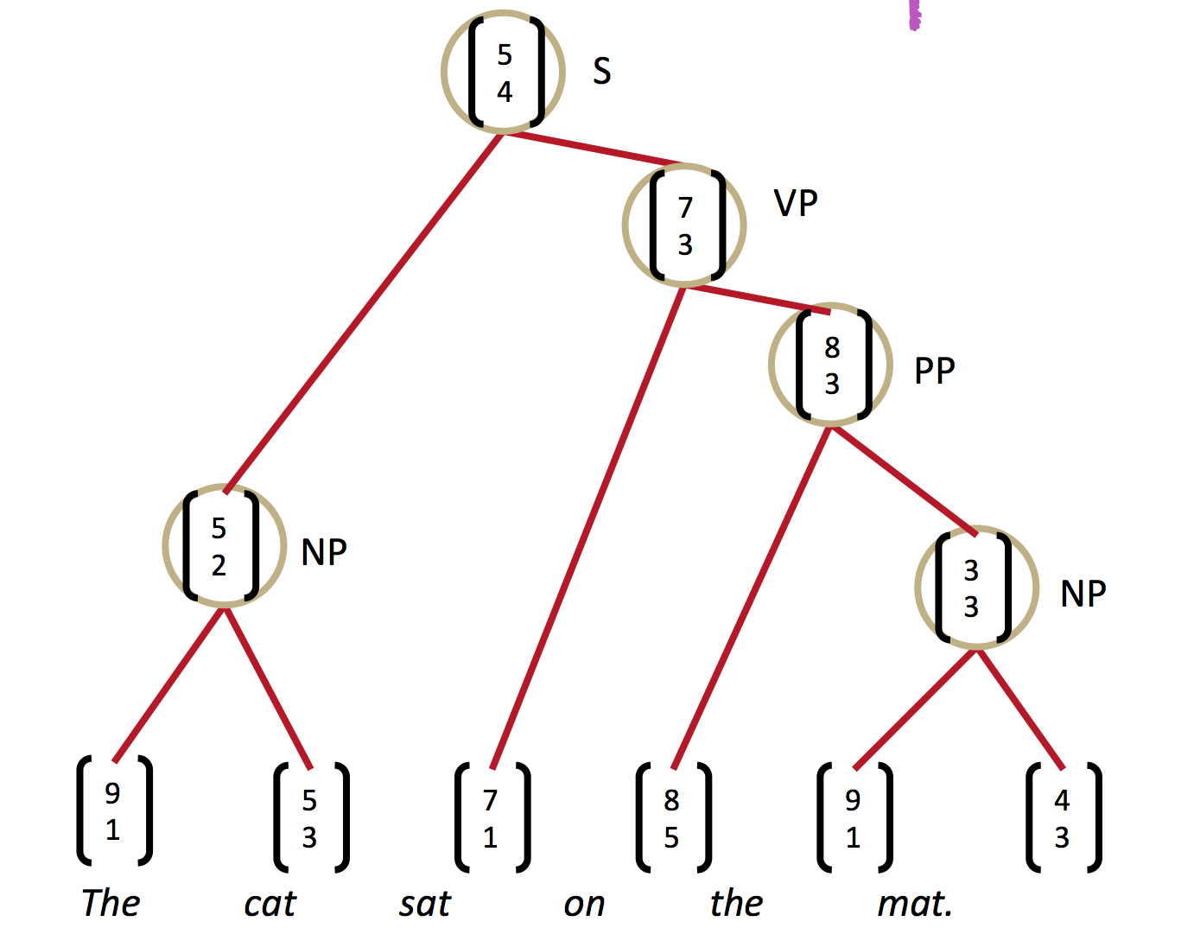
Meaning of a sentence determined by –
Meanings of its words
The rules that combine them
Recursive neural nets can jointly learn compositional vector representation and parse trees.

Slide 7
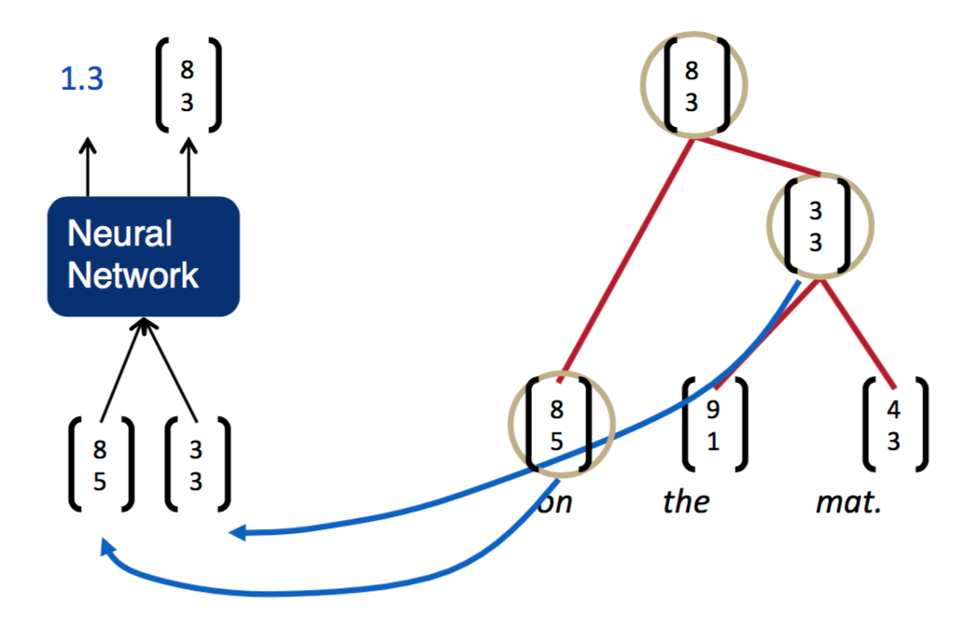
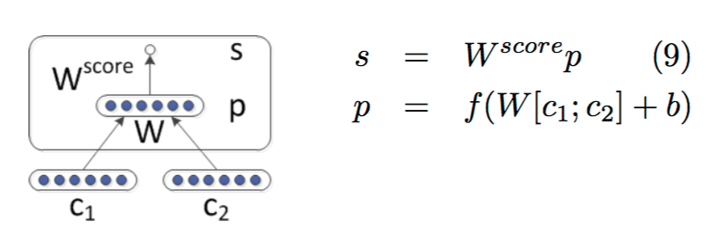
Merging Representations
Input: Two candidate nodes to be merged
Output: Semantic representation of the two merged nodes and a score of goodness of merging the two nodes.

Slide 8
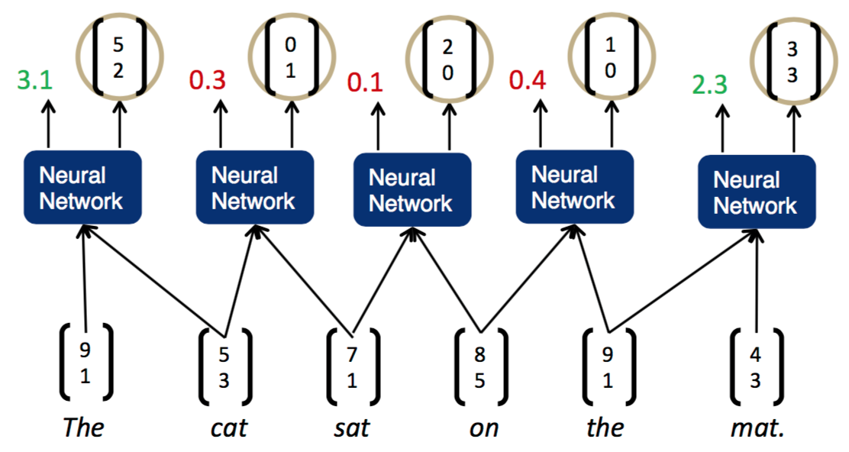
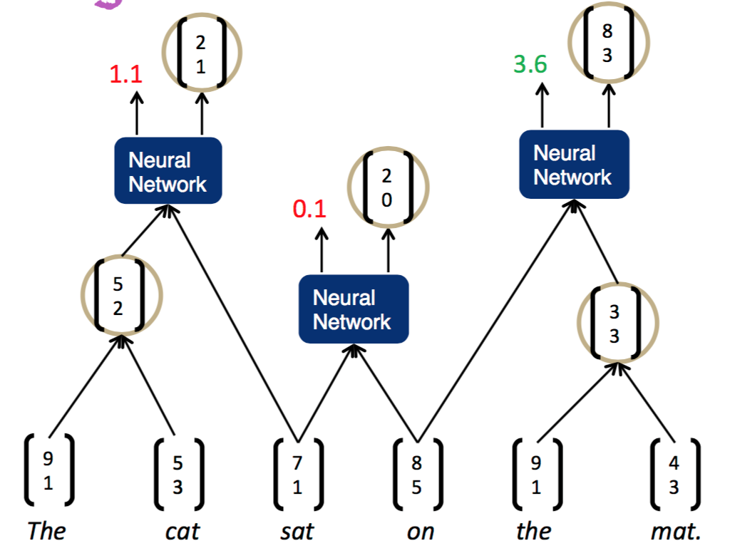

Slide 9
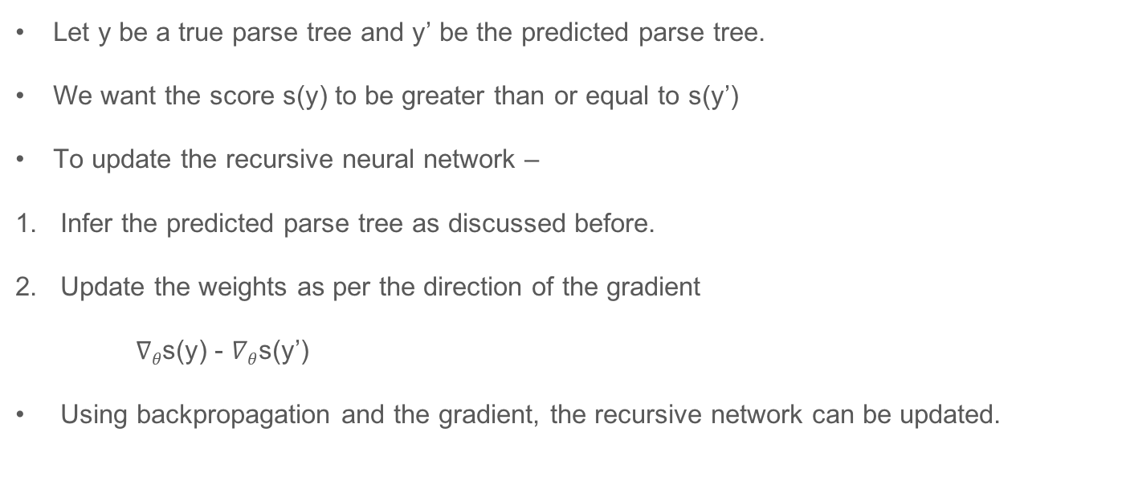
Training
Let y be a true parse tree and y’ be the predicted parse tree.
We want the score s(y) to be greater than or equal to s(y’)
To update the recursive neural network –
Infer the predicted parse tree as discussed before.
Update the weights as per the direction of the gradient
$∇θ$s(y) - $∇θ$s(y’)
Using backpropagation and the gradient, the recursive network can be updated.

Slide 10
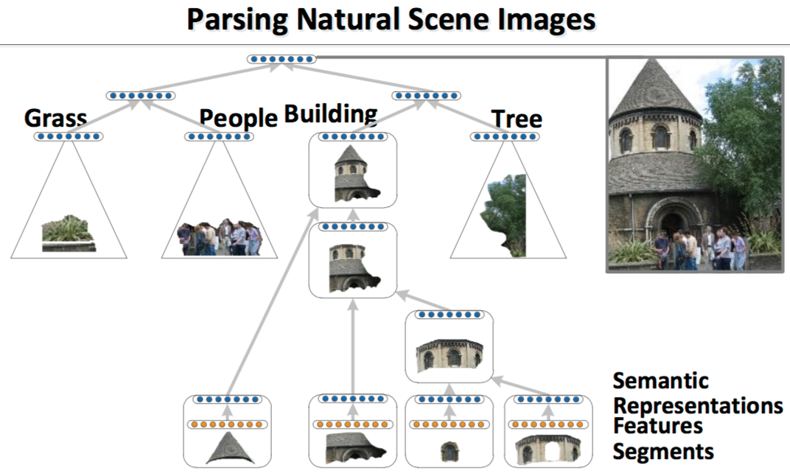

Slide 11
References
http://nlp.stanford.edu/pubs/SocherLinNgManning_ICML2011.pdf
http://veredshwartz.blogspot.co.il/2016/01/representing-words.html
http://www.iro.umontreal.ca/~bengioy/talks/gss2012-YB6-NLP-recursive.pdf
http://techtalks.tv/talks/deep-learning-for-nlp-without-magic-part-2/58415/

